Slide 1

Byte Ordering
Unit - 2

Slide 2
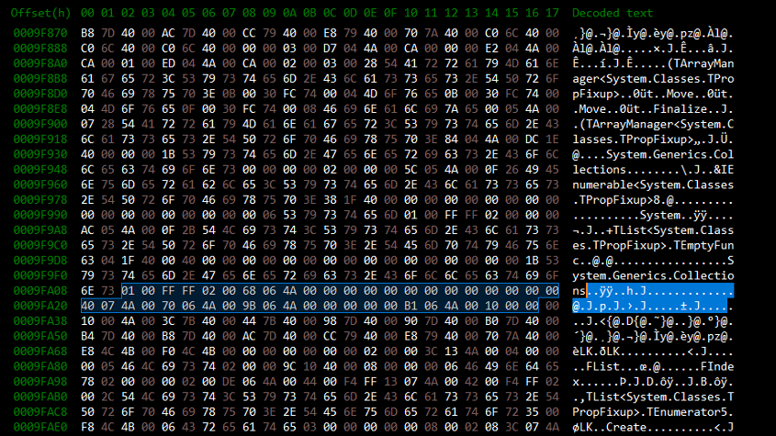
BYTE ORDERING
An arrangement of bytes when data is transmitted over the network is called byte ordering.
Different computers will use different byte ordering.
When communication taking place between two machines byte ordering should not make discomfort.
Generally an Internet protocol will specify a common form to allow different machines byte ordering. TCP/IP is the Internet Protocol in use.
Two ways to store bytes : Big endian and little endian
Big-endian
High order byte is stored on starting address and low order byte is stored on next address
Little-endian
Low order byte is stored on starting address and high order byte is stored on next address

Slide 3
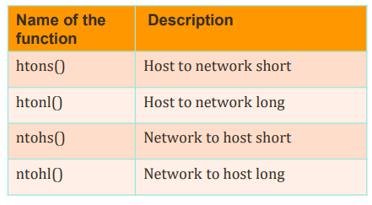
Byte ordering functions
Special functions are applied through routines to convert host’s internal byte order representation to network byte order.
unsigned short htons()
This function converts 16-bit (2-byte) data from host byte order to network byte order.
unsigned long htonl()
This function converts 32-bit (4-byte) data from host byte order to network byte order.
unsigned short ntohs()
This function converts 16-bit (2-byte) data from network byte order to host byte order.
unsigned long ntohl()
This function converts 32-bit (4- byte) data from network byte order to host byte order.
Byte Ordering Functions

Slide 4
SYSTEM CALLS & SOCKETS
System calls
System Calls – An interface between process and operating systems.
It provides
The services of the operating system to the user programs via Application Program Interface(API).
An interface to allow user-level processes to request services of the operating system.
System calls are the only entry points into the kernel system.

Slide 5
SYSTEM CALLS & SOCKETS
Sockets
Socket is an interface between applications and the network services provided by operating systems.
Applications use sockets to send and receive the data.
Socket provides IP address and port address
APPLICATION
SOCKET – APPICATION INTERFACE(API)
TCP/IPV4, TCP/IPV6, UNIX

Slide 6
Socket Descriptors
To perform file I/O, file descriptor is used.
To perform network I/O, socket descriptor is used
Each active socket is identified by its socket descriptor.
The data type of a socket descriptor is SOCKET.
Hack into the header file winsock2.h:
typedef u_int SOCKET; /* u_int is defined as unsigned int */
In UNIX systems, socket is just a special file, and socket descriptors are kept in the file descriptor table.
The Windows operating system keeps a separate table of socket descriptors (named socket descriptor table, or SDT) for each process.

Slide 7
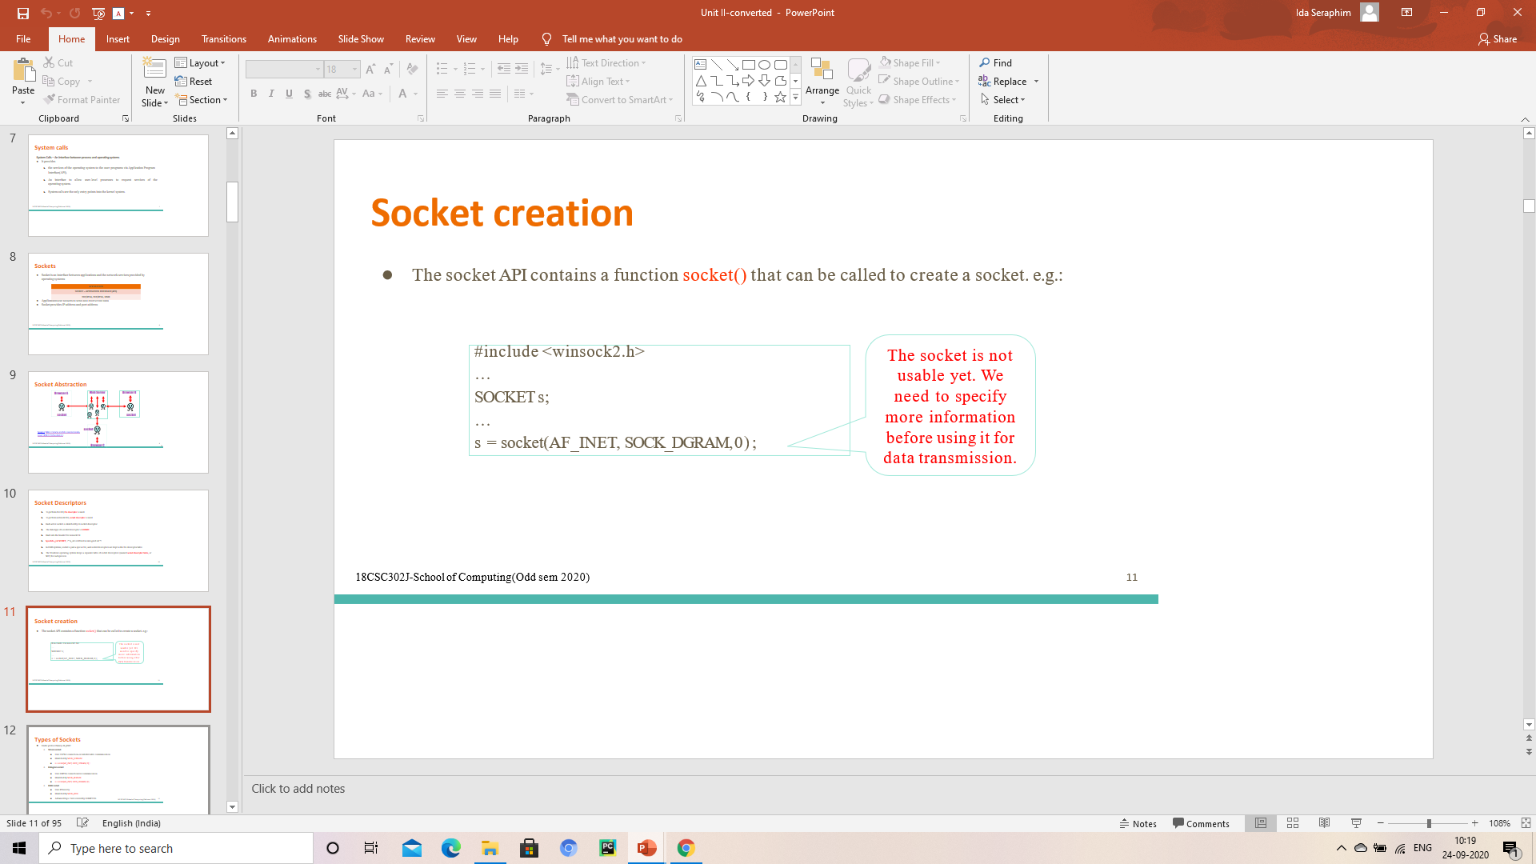
Socket creation
The socket API contains a function socket() that can be called to create a socket.

Slide 8
Types of Sockets
Under protocol family AF_INET
Stream socket
Uses TCP for connection-oriented reliable communication
Identified by SOCK_STREAM
s = socket(AF_INET, SOCK_STREAM, 0) ;
Datagram socket
Uses UDP for connectionless communication
Identified by SOCK_DGRAM
s = socket(AF_INET, SOCK_DGRAM, 0) ;
RAW socket
Uses IP directly
Identified by SOCK_RAW

Slide 9
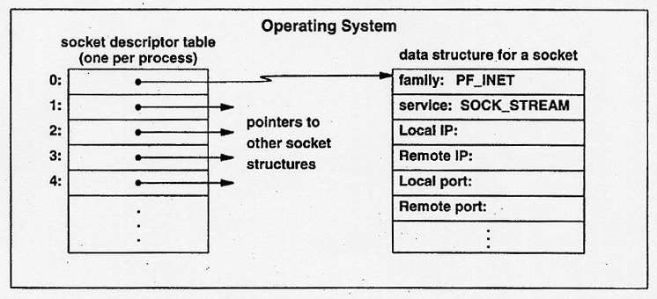
System Data Structures for Sockets
When an application process calls socket(), the operating system allocates a new data structure to hold the information needed for communication, and fills in a new entry in the process’s socket descriptor table (SDT) with a pointer to the data structure.
A process may use multiple sockets at the same time. The socket descriptor table is used to manage the sockets for this process.
Different processes use different SDTs.
The internal data structure for a socket contains many fields, but the system leaves most of them unfilled. The application must make additional procedure calls to fill in the socket data structure before the socket can be used.
The socket is used for data communication between two processes (which may locate at different machines). So the socket data structure should at least contain the address information, e.g., IP addresses, port numbers, etc.
Data Structure for Sockets

Slide 10
Functions used in client program
socket()- create the socket descriptor
connect()- connect to the remote server
read(),write()- communicate with the server
close()- end communication by closing socket descriptor

Slide 11
Socket()
int socket(int domain, int type, int protocol)
Returns a descriptor (or handle) for the socket
Domain
protocol family PF_INET for the Internet
Type
semantics of the communication
SOCK_STREAM: Connection oriented
SOCK_DGRAM: Connectionless
Protocol
specific protocol UNSPEC: unspecified (PF_INET and SOCK_STREAM already implies TCP)
E.g., TCP: sd = socket(PF_INET, SOCK_STREAM, 0);
E.g., UDP: sd = socket(PF_INET, SOCK_DGRAM, 0);

Slide 12
Connect()
int connect(int sockfd, struct sockaddr *server_address, socketlen_t addrlen)
Arguments
socket descriptor, server address, and address size
Remote address and port are in struct sockaddr
Returns 0 on success, and -1 if an error occurs

Slide 13
Read(), Write() and Close()
Sending data
write(int sockfd, void *buf, size_t len)
Arguments: socket descriptor, pointer to buffer of data, and length of the buffer
Returns the number of characters written, and -1 on error
Receiving data
read(int sockfd, void *buf, size_t len)
Arguments: socket descriptor, pointer to buffer to place the data, size of the buffer
Returns the number of characters read (where 0 implies “end of file”), and -1 on error
Closing the socket
int close(int sockfd)

Slide 14
Functions used in server program
socket()- create the socket descriptor
bind()- associate the local address
listen()- wait for incoming connections from clients
accept()- accept incoming connection
read(),write()- communicate with client
close()- close the socket descriptor

Slide 15
Bind()
Bind socket to the local address and port
int bind (int sockfd, struct sockaddr *my_addr, socklen_t addrlen)
Arguments: socket descriptor, server address, address length.
Returns 0 on success, and -1 if an error occurs.

Slide 16
Listen()
Define the number of pending connections
int listen(int sockfd, int backlog)
Arguments: socket descriptor and acceptable backlog
Returns 0 on success, and -1 on error

Slide 17
Accept()
int accept(int sockfd, struct sockaddr *addr, socketlen_t *addrlen)
Arguments: socket descriptor, structure that will provide client address and port, and length of the structure.
Returns descriptor for a new socket for this connection
What happens if no clients are around?
The accept() call blocks waiting for a client
What happens if too many clients are around?
Some connection requests don’t get through
But, that’s okay, because the Internet makes no promises

Slide 18
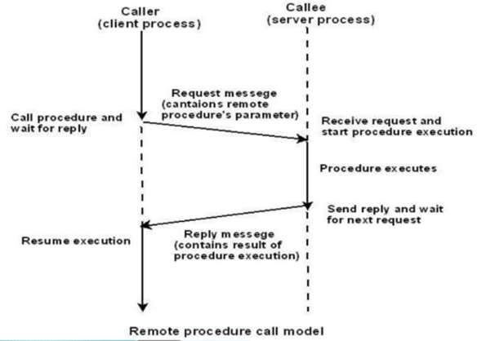
RPC – REMOTE PROCEDURE CALL
A remote procedure call is an interprocess communication technique that is used for client-server based applications. It is also known as a subroutine call or a function call.
RPC allows programs to call the procedure which is located on the other machines.
Message passing is not visible to the programmer , so it is called as Remote Procedure call (RPC).
RPC enables a procedure call that does not reside in the address space of the calling process.
In RPC, the caller and the callee has disjoint address space, hence there is no access to data and variables in the callers environment.
RPC performs a message passing scheme for information exchange between the caller and the callee process.

Slide 19
RPC Model(Remote Procedure Call)
A client has a request message that the RPC translates and sends to the server.
This request may be a procedure or a function call to a remote server.
When the server receives the request, it sends the required response back to the client.
The client is blocked while the server is processing the call and only resumed execution after the server is finished.

Slide 20
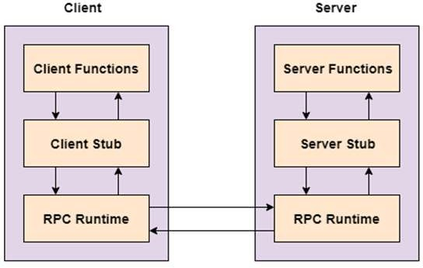
Client Server RPC Model
Sequence of events in a RPC
The client stub is called by the client.
The client stub makes a system call to send the message to the server and puts the parameters in the message.
The message is sent from the client to the server by the client’s operating system.
The message is passed to the server stub by the server operating system.
The parameters are removed from the message by the server stub.
Then, the server procedure is called by the server stub.

Slide 21
RPC Features
Remote procedure calls support process oriented and thread oriented models.
The internal message passing mechanism of RPC is hidden from the user.
The effort to re-write and re-develop the code is minimum in remote procedure calls.
Remote procedure calls can be used in distributed environment as well as the local environment.
Many of the protocol layers are omitted by RPC to improve performance.
Ease of use, efficiency.

Slide 22
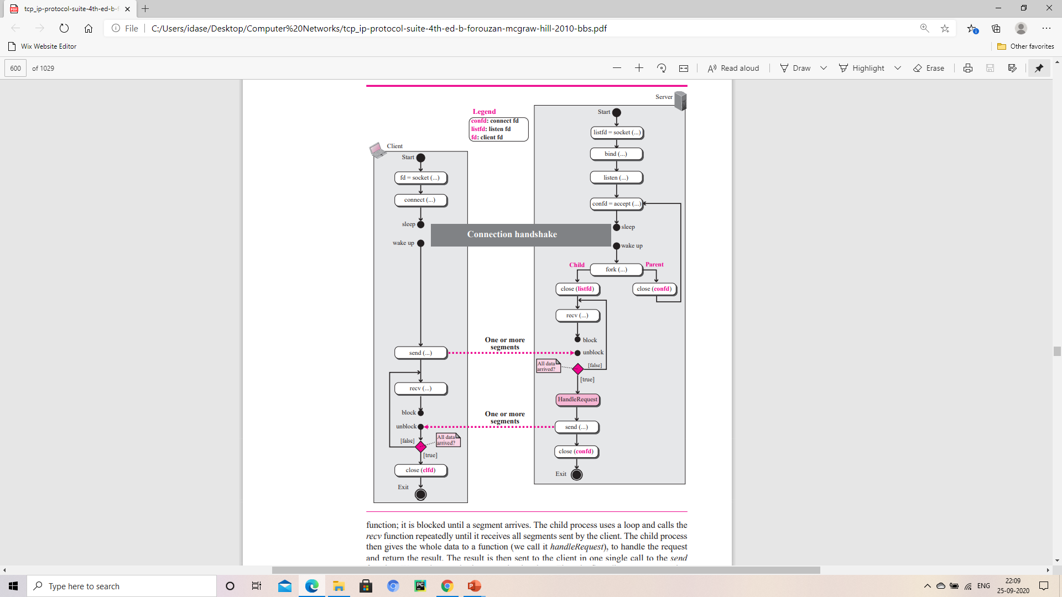
TCP CLIENT –SERVER Communication
Communication Using TCP
Accept function
This function is a blocking function; when it is called, it is blocked until the TCP receives a connection request (SYN segment) from a client.
The accept function then is unblocked and creates a new socket called the connect socket that includes the socket address of the client that sent the SYN segment.
After the accept function is unblocked, the server knows that a client needs its service.
To provide concurrency, the server process (parent process) calls the fork function.
This function creates a new process (child process), which is exactly the same as the parent process.
After calling the fork function, the two processes are running concurrently, but each can do different things
Flow diagram for connection-oriented, concurrent communication

Slide 23
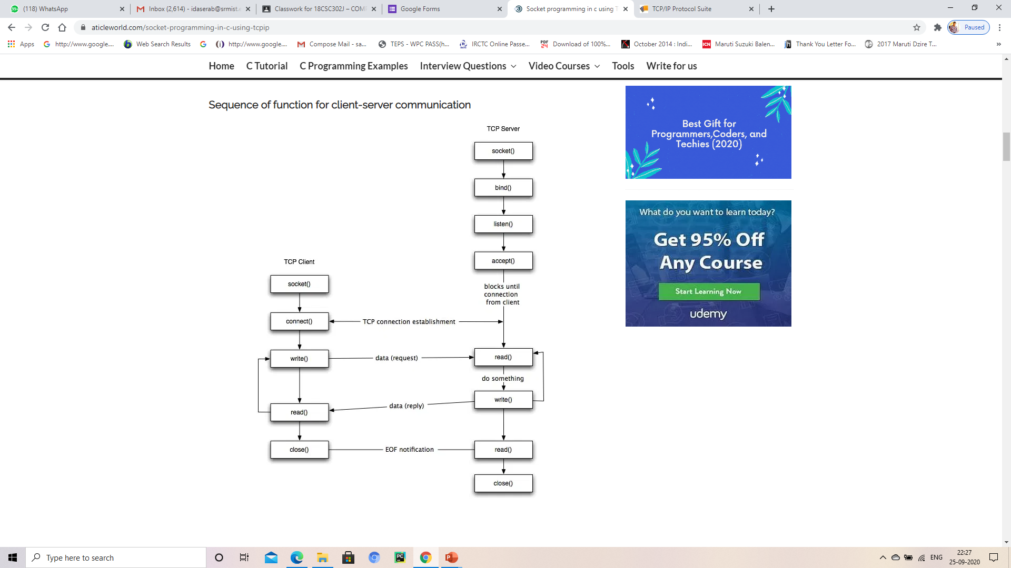
Sequence of function for client-server communication
Steps to create a client using TCP/IP API
Create a socket using the socket() function.
Initialize the socket address structure as per the server and connect the socket to the address of the server using the connect();
Receive and send the data using the recv() and send() function
Close the connection by calling the close() function.
Steps to create a server using TCP/IP API
Create a socket using the socket() function.
Initialize the socket address structure and bind the socket to an address using the bind() function.
Listen for connections with the listen() function.
Accept a connection with the accept() function system call. This call typically blocks until a client connects to the server.
Receive and send data by using the recv() and send() function.
Close the connection by using the close() function.

Slide 24
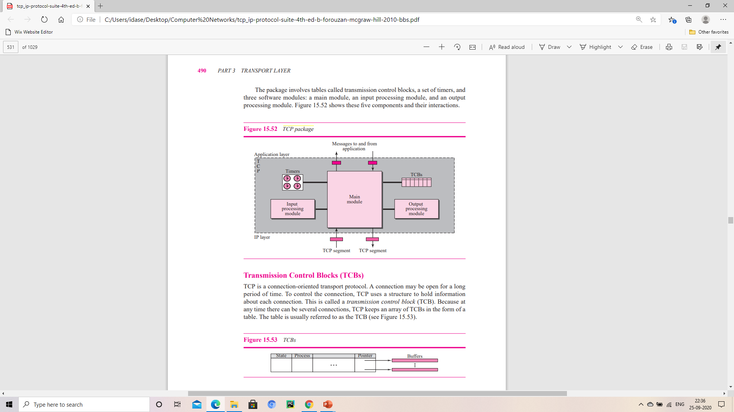
TCP Package - Input, Output Processing Module
TCP Package
TCP is a stream-service, connection-oriented protocol with an involved state transition diagram.
It uses flow and error control.
It is so complex because actual code includes tens of thousands of lines.
TCP package

Slide 25
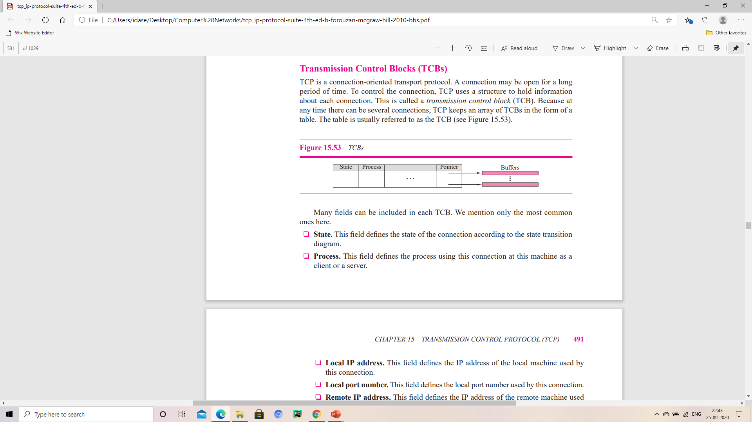
Transmission Control Blocks (TCBs)
TCP is a connection-oriented transport protocol.
A connection may be open for a long period of time.
To control the connection, TCP uses a structure to hold information about each connection.
This is called a transmission control block (TCB).
Fields in TCB
State Local window Buffer size
Process Remote window Buffer pointer
Local IP address Sending sequence number
Local port number Receiving sequence number
Remote IP address Sending ACK number
Remote port number Round-trip time
Interface Time-out values
TCBs

Slide 26
TCP Package
Timers
TCP needs to keep track of its operations.
Three software modules
Main module
An input processing module
An output processing module
Input Processing Module
The Input processing module handles all the details which is required for the processing of data or an acknowledgement received when TCP is in the ESTABLISHED STATE.
This module sends an ACK if needed.
Takes care of the window size
Performs Error checking and so on.

Slide 27
TCP Package
Output Processing Module
The output processing module handles all the details needed to send out data received from application program when TCP is in the ESTABLISHED STATE.
This module handles retransmission time-outs, persistent time-outs and so on.

Slide 28
UDP – USER DATAGRAM PROTOCOL
Connectionless
Unreliable transport protocol
Located between application layer and network layer in the TCP/IP protocol suite
Process to process communication using port numbers
Limitations of UDP
There is no flow control mechanism.
There is no acknowledgement for received packets.
Does not provide error control to some extent.

Slide 29
Why would a process want to use UDP when it is powerless?
It is simple protocol with minimum overhead.
Application which use small messages to be sent without reliability in that case UDP is the best.
For small messages less no. of interactions is required between sender and receiver for UDP compared to TCP.

Slide 30
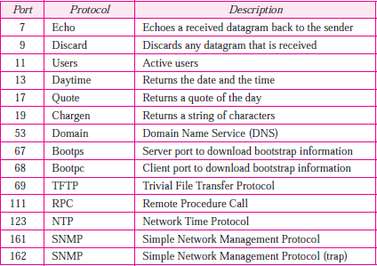
UDP Services
Process to Process communication
UDP provides process-to-process communication using sockets, a combination of IP addresses and port numbers. Several port numbers used by UDP.
Connectionless services
Each datagram is independent even it comes from same source and delivered in same destination.
The datagrams are not numbered.
No connection establishments is done.
Cannot send a stream of data to UDP, It will chop them into different packets related user datagrams.
Well Known Ports used in UDP

Slide 31
UDP Services
Flow control
No Flow Control and no window mechanism.
The receiver may overflow with incoming messages.
UDP should provide for this service, if needed.
Error Control
No Error control mechanism except for checksum.
Sender is unknown about the loss and duplication.
When error detects in receiver the datagram is discarded.
Congestion control
Does not provide congestion control and has an assumption that the packets are small and sporadic so they cant create congestion.

Slide 32
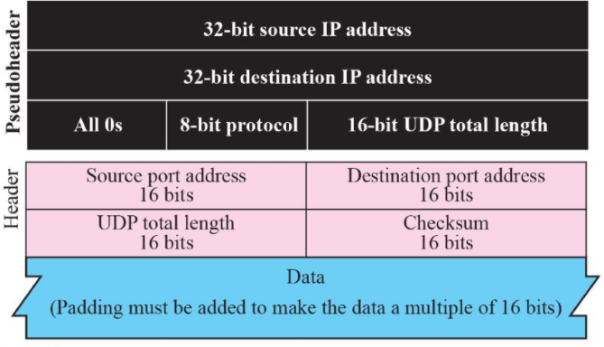
UDP Services
Checksum
Three sections: a pseudo header, the UDP header, and the data coming from the application layer.
Pseudo header
It is a part of the IP header
Encapsulated with some fields with 0’s
Protocol field to differentiate between UDP and TCP
The value of the protocol field is 17. If it is changed then the packet gets discarded at receiver end.
UDP header
Data
communication from the application layer
Pseudo header for checksum calculation

Slide 33
UDP Services
Encapsulation and Decapsulation
Encapsulation
A process send message through UDP
Along with a pair of socket address and the length of data.
UDP receives data and add UDP header then pass to IP with socket.
IP add its own header using value 17 in protocol field.
Indicating UDP protocol.
The IP datagram is then passed to the data link layer.
The data link layer receives the IP datagram and passes it to the physical layer.
The physical layer encodes the bits into electrical or optical signals and sends it to the remote machine.

Slide 34
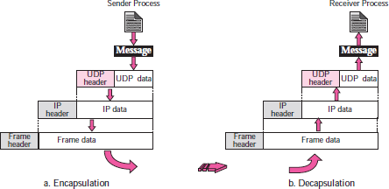
Decapsulation
At the destination host
The physical layer decodes the signals and pass it to the data link layer.
The data link layer uses the header (and the trailer) to check the data.
If there is no error
The header and trailer are dropped , datagram is passed to IP.
The header is dropped and the user datagram is passed to UDP with the sender and receiver IP addresses.
Checksum is to check the entire user datagram.
The header is dropped and the application data along with the sender socket address is passed to the process.
The sender socket address is passed to the process in case it needs to respond to the message received.

Slide 35
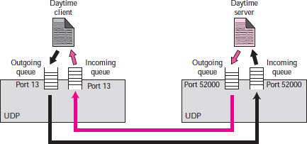
Queuing in UDP
At the client site, when a process starts, it requests a port number from the operating system. Some implementations create both an incoming and an outgoing queue associated with each process. Other implementations create only an incoming queue associated with each process
Process wants to communicate with multiple processes, it obtains only one port number and eventually one outgoing and one incoming queue. The queues opened by the client are, in most cases, identified by ephemeral port numbers. The queues function as long as the process is running. When the process terminates, the queues are destroyed.
The client process can send messages to the outgoing queue by using the source port number specified in the request
Queuing in UDP

Slide 36
Queuing in UDP
The client process can send messages to the outgoing queue by using the source port number specified in the request
UDP removes the messages one by one and, after adding the UDP header, delivers them to IP. An outgoing queue can overflow
It happens the operating system can ask the client process to wait before sending any more messages

Slide 37
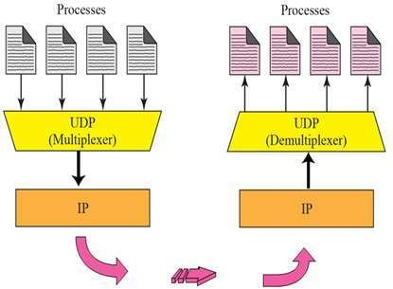
Multiplexing & Demultiplexing
Multiplexing
Many to one relationship.
UDP accepts messages from different process and differentiate by port numbers.
Adds a header and then sends to the IP
Demultiplexing
One to many relationship.
UDP receives the user datagram from IP and drops the header then sends the message to appropriate process based on port numbers.

Slide 38
UDP Features
Connectionless services
Lack of error control
Lack of congestion control

Slide 39
Connectionless service
Preferable for small message which fits in a single datagram.
The overhead to establish and close a connection may be significant whereas in TCP it takes 9 packets for exchanges between client and server to achieve the above goal.
Provides less delay

Slide 40
Lack of error control
UDP does not provide error control.
Provides unreliable service.
In reliable service the transport layer needs to take care of the lost packet by resending it. So there will be a uneven delay between different parts of the message delivered.

Slide 41
Lack of congestion control
UDP does not provide congestion control.
UDP does not provide additional traffic in error prone network.
TCP leads to creation of congestion or additional congestion in network by resending packets several times when a packet are lost.

Slide 42
UDP Applications
Used for simple request response communication when size of data is less hence there is lesser concern about flow and error control.
It is suitable protocol for multicasting as UDP supports packet switching.
Following implementations uses UDP as a transport layer protocol
NTP (Network Time Protocol)
DNS (Domain Name Service)
BOOTP, DHCP.
NNP (Network News Protocol)
Quote of the day protocol
TFTP, RTSP, RIP, OSPF.
UDP is null protocol if you remove checksum field.

Slide 43
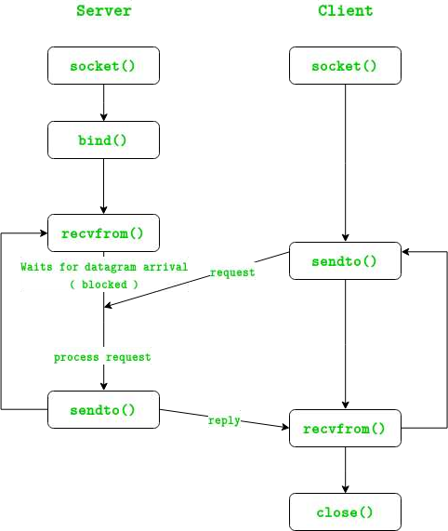
UDP CLIENT – SERVER AND PACKAGES
Server Processing using UDP
Create UDP socket.
Bind the socket to server address.
Wait until datagram packet arrives from client.
Process the datagram packet and send a reply to client.
Go back to Step 3.
Client Processing using UDP
Create UDP socket.
Send message to server.
Wait until response from server is received.
Process reply and go back to step 2, if necessary.
Close socket descriptor and exit.

Slide 44
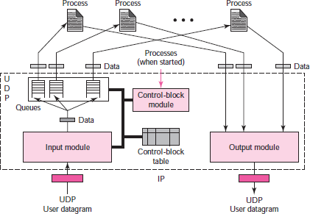
UDP Package
The UDP package involves five components
Control-Block Table
UDP has a control-block table to keep track of the open ports.
Each entry in this table has a minimum of four fields: the state, which can be FREE or IN-USE, the process ID, the port number, and the corresponding queue number.
Input Queues
UDP package uses a set of input queues, one for each process. In this design, we do not use output queues.
UDP design

Slide 45
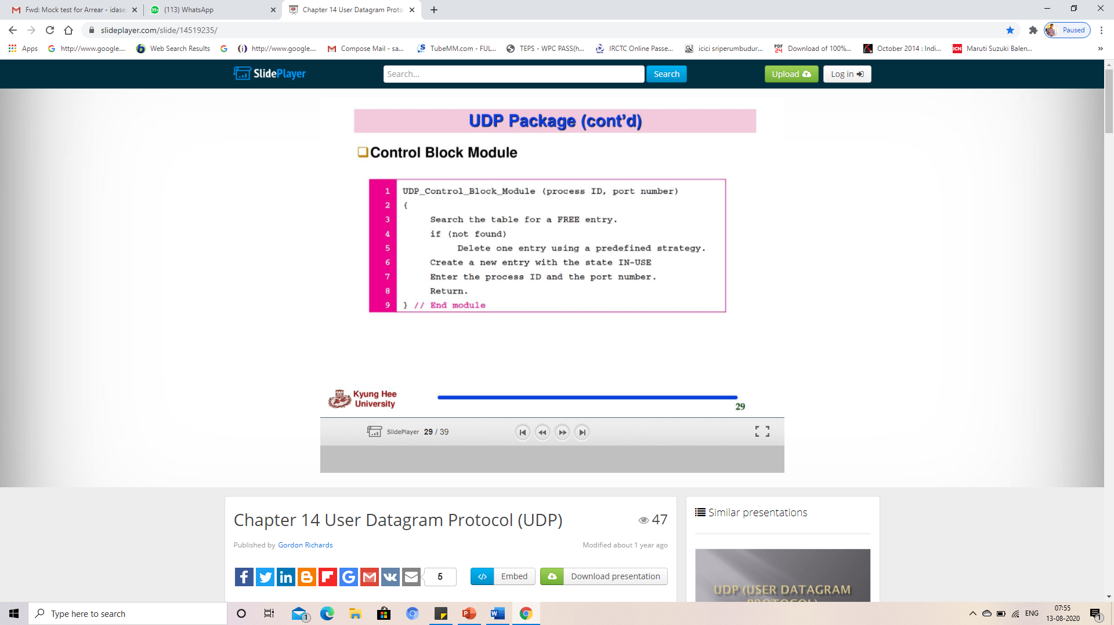
UDP Package
Control-Block Module
The control-block module is responsible for the management of the control-block table.
When a process starts, it asks for a port number from the operating system.
The operating system assigns well- known port numbers to servers and ephemeral port numbers to clients.
The process passes the process ID and the port number to the control-block module to create an entry in the table for the process.

Slide 46
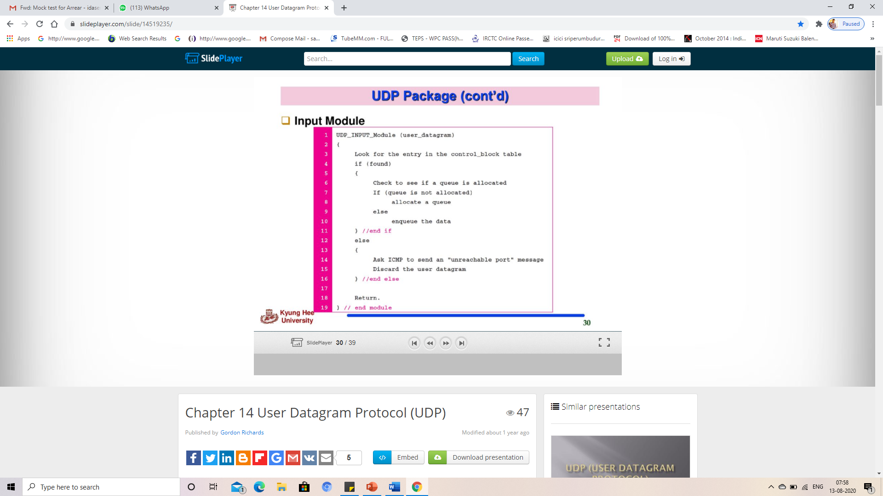
UDP Package
Input Module
The input module receives a user datagram from the IP. It searches the control-block table to find an entry having the same port number as this user datagram.
If the entry is found, the module uses the information in the entry to enqueue the data. If the entry is not found, it generates an ICMP message.

Slide 47
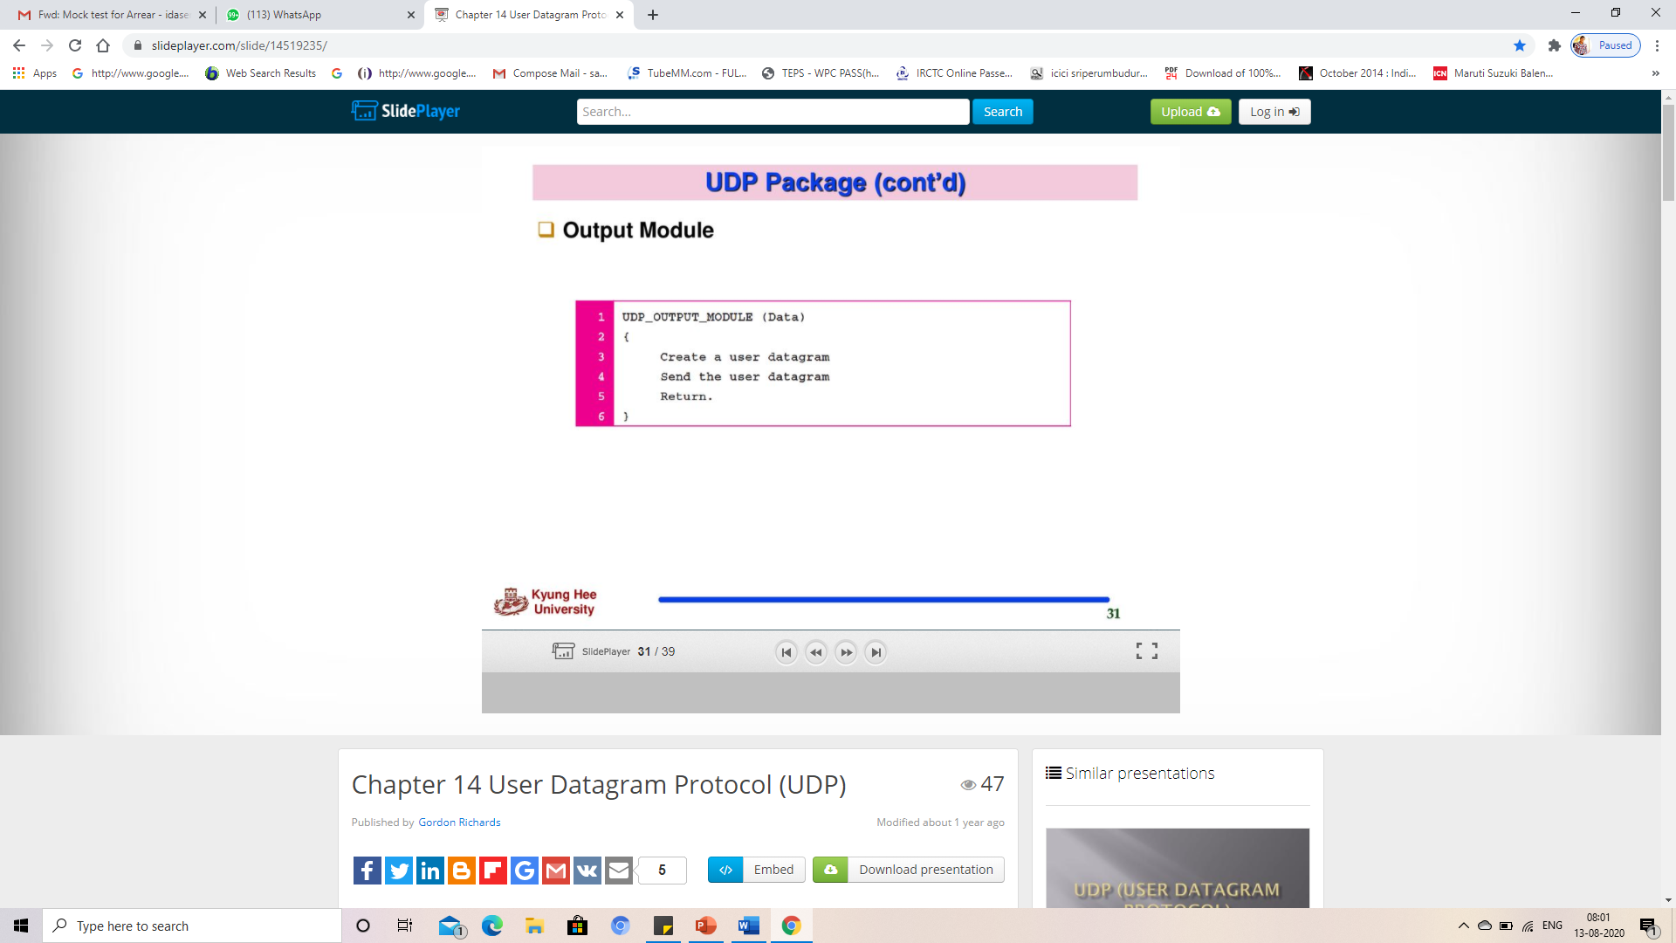
UDP Package
Output module
The output module is responsible for creating and sending user datagrams.

Slide 48
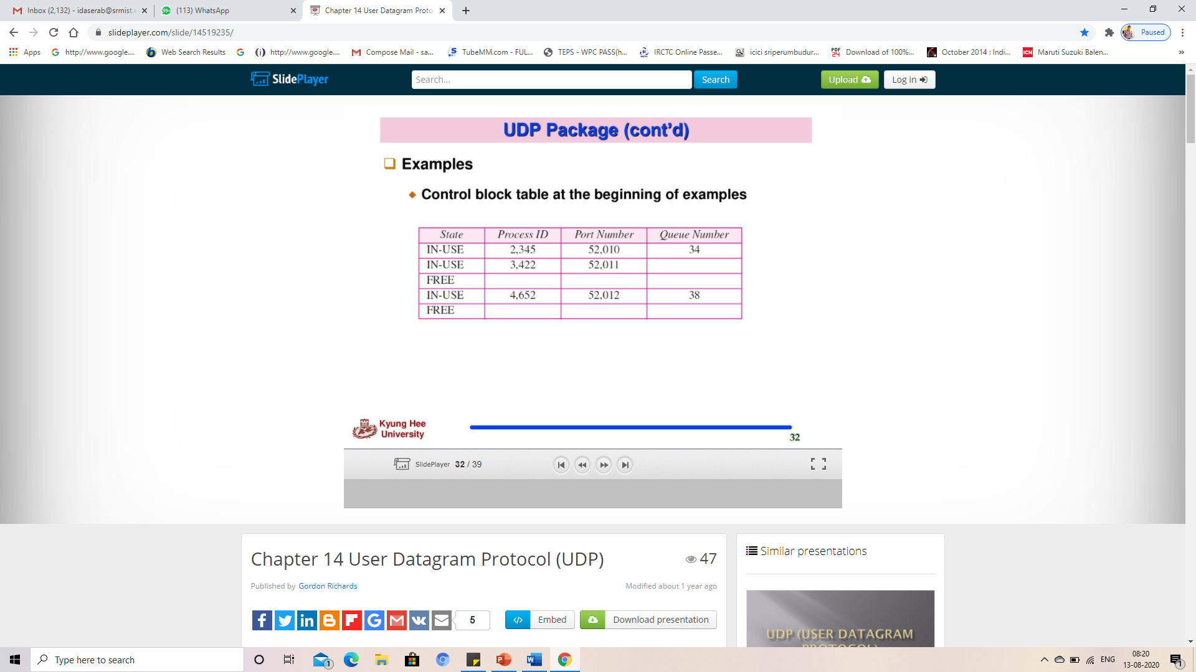
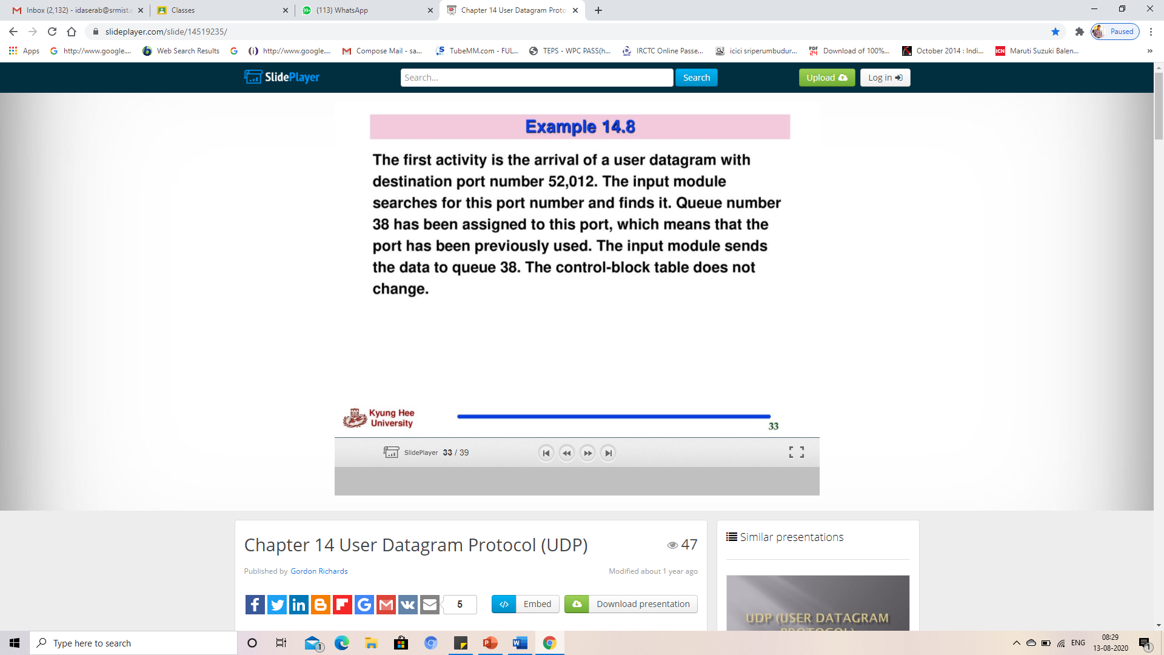
Example

Slide 49
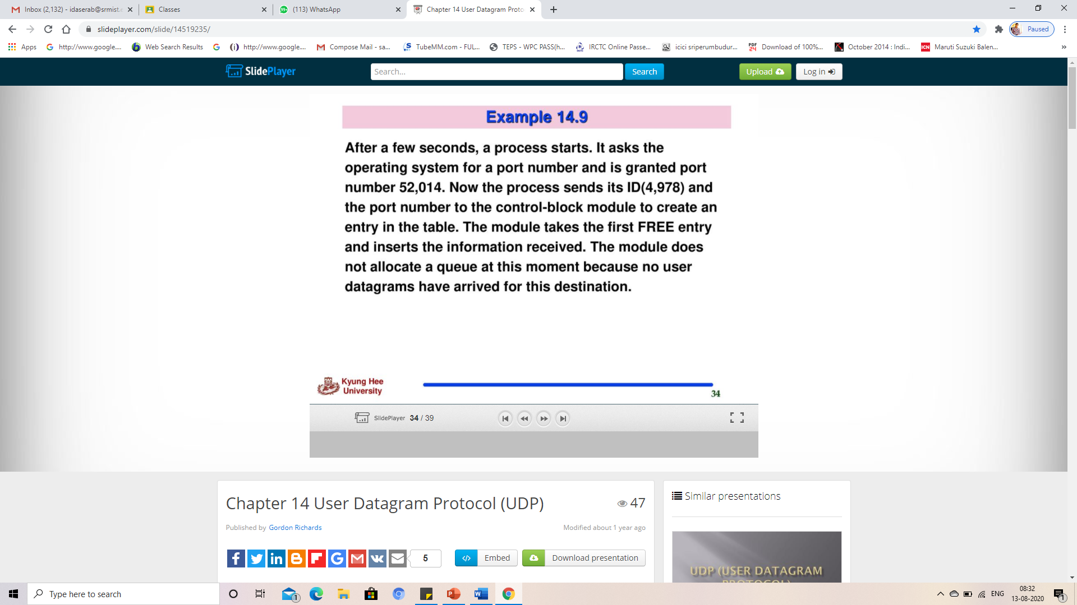
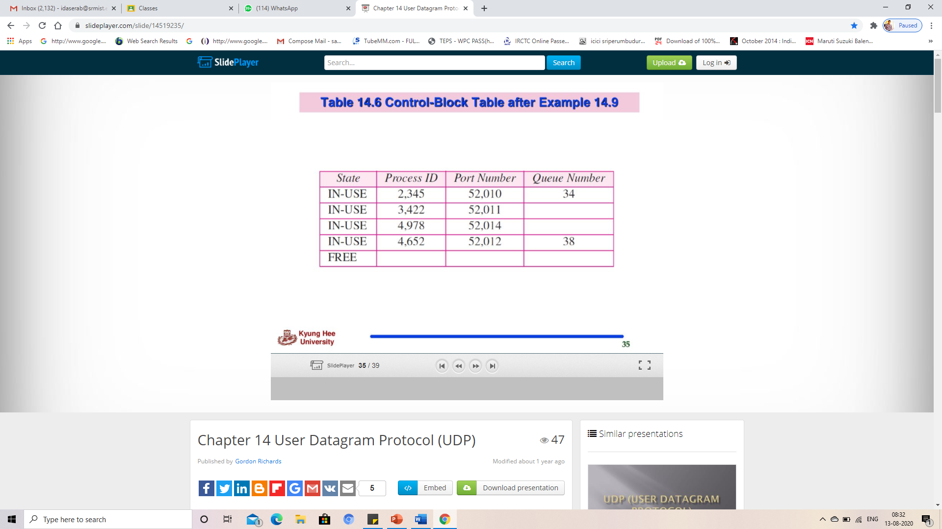
Example

Slide 50
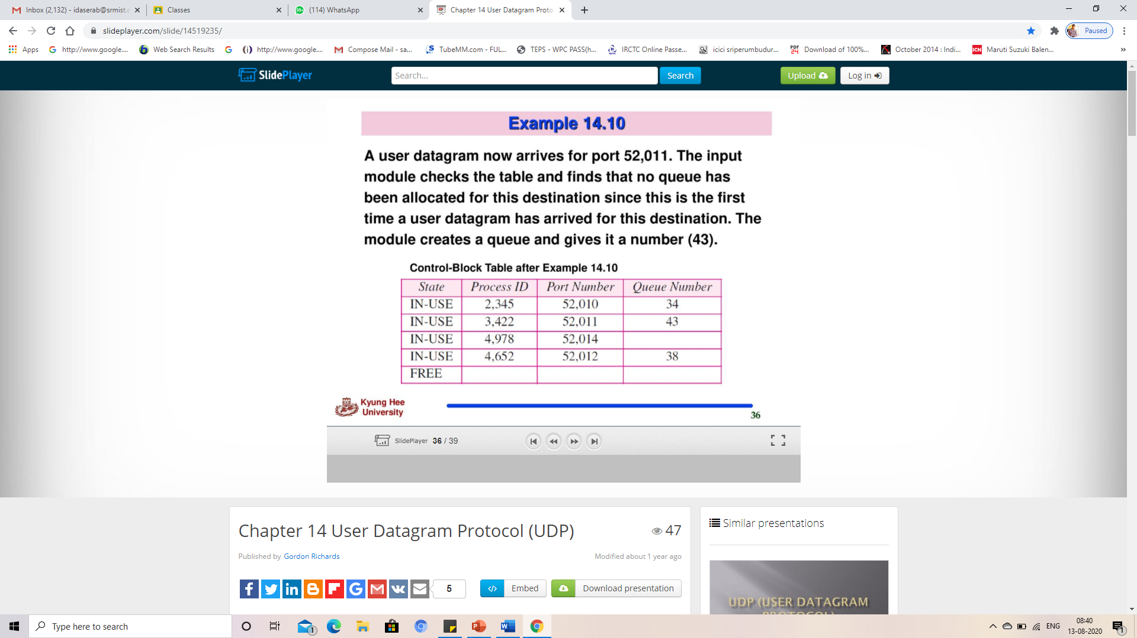
Example

Slide 51
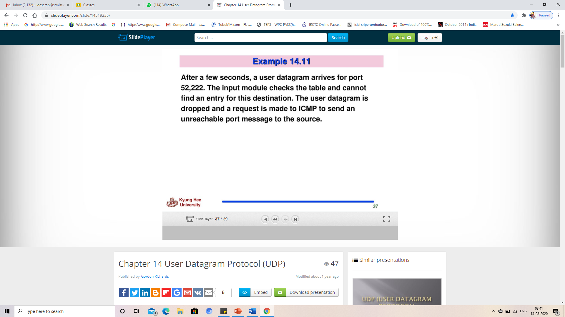
Example

Slide 52
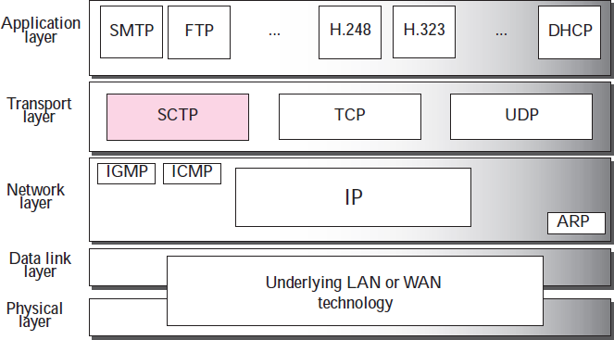
Stream Control Transmission Protocol (SCTP)
SCTP is designed as a general-purpose transport layer protocol that can handle multimedia and stream traffic, which are increasing every day on the Internet.
It is a new reliable, message-oriented transport-layer protocol.
Relationship of SCTP to the other protocols in the
Internet protocol suite

Slide 53
Stream Control Transmission Protocol (SCTP)
Comparison between UDP, TCP, and SCTP
UDP | TCP | SCTP
Message - oriented protocol | Byte-oriented protocol | Best features of UDP and TCP
UDP conserves the message boundaries | No preservation of the message boundaries | Preserves the message boundaries along with detection of lost data, duplicate data, and out-of-order data
UDP is unreliable | TCP is a reliable protocol | SCTP is a reliable message oriented Protocol
Lacks in congestion control and flow control | TCP has congestion control and flow control mechanisms | It has congestion control and flow control mechanisms
SCTP is a message-oriented, reliable protocol that combines the best features of UDP and TCP.

Slide 54
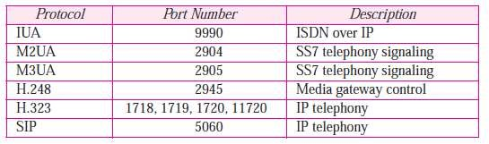
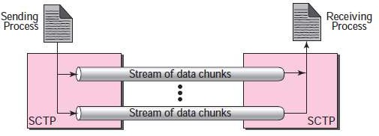
SCTP Services
Process-to-Process Communication
SCTP uses all well-known ports in the TCP space
Multiple Streams
SCTP allows multi stream service in each connection called as association
If one of the streams is blocked, the other streams can still deliver their data
Some SCTP applications
Multiple-stream concept

Slide 55
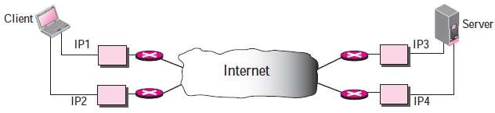
SCTP Services
Multihoming
The sending and receiving host can define multiple IP addresses in each end for an association.
when one path fails, another interface can be used for data delivery without interruption.
This fault-tolerant feature helps in sending and receiving a real-time payload such as Internet telephony.
Full-Duplex Communication
SCTP has sending and receiving buffer, hence packets are sent in both directions.
Multihoming concept

Slide 56
SCTP Services
Connection-Oriented Service
A connection is called an association in SCTP
Steps to send and receive data in SCTP
The two SCTP’s establish an association between each other.
Data are exchanged in both directions.
The association is terminated.
Reliable Service
It uses an acknowledgment mechanism to check the safe and sound arrival of data.

Slide 57
SCTP Services
Transmission Sequence Number (TSN)
Unit of data in SCTP is called the data chunk.
Data transfer in SCTP is controlled by numbering the data chunks.
SCTP uses a TSN to number the data chunks with 32 bits long number which is randomly initialized between 0 and 2³²− 1.
Each data chunk carry their TSN in its header.
Stream Identifier (SI)
Each stream in SCTP needs to be identified using a SI.
Each data chunk carry SI in its header.
when it arrives at the destination, it is placed in order in its stream.
The SI is a 16-bit number starting from 0.

Slide 58
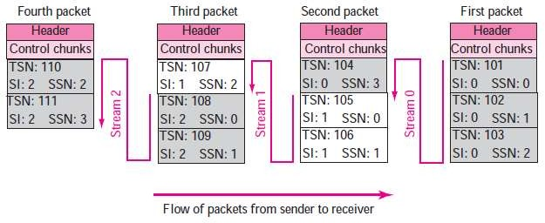
SCTP Services
Stream Sequence Number (SSN)
When a data chunk arrives at the destination SCTP, it is delivered to the appropriate stream in the proper order.
In addition to an SI, SCTP defines a SSN in each data chunk in each stream.
Packets
Data are carried as data chunks, control information as control chunks.
Several control chunks and data chunks can be packed together in a packet.
Packet, data chunks, and streams

Slide 59
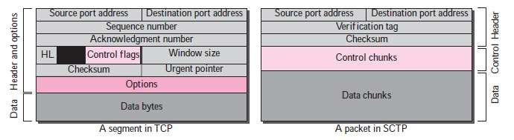
SCTP Features
Comparison between a TCP segment and an SCTP packet
TCP segment | SCTP packet
Control information is part of the header | Control information is included in the control chunks
Data is treated as one entity | Carry several data chunks, each can belong to a different stream
Options section exist separately | Options are handled by defining new chunk types
Mandatory part of header is 20 bytes | General header is only 12 bytes
Checksum is 16 bits | Checksum is 32 bits
Combination of IP and port addresses define a connection | Verification tag is an association identifier
Includes one sequence number in the header | Includes several different data chunks
Some segments carry control information | Control chunks never use a TSN, IS, or SSN number, they are used for data chunks only

Slide 60
SCTP Features
Acknowledgment Number
SCTP acknowledgment numbers are chunk-oriented refer to TSN
Control information is carried by control chunks, which do not need a TSN
Control chunks are acknowledged by another control chunk of the appropriate type
Flow Control
SCTP implements flow control to avoid overwhelming receiver
Error Control
TSN numbers and acknowledgment numbers are used for error control.
Congestion Control
SCTP implements congestion control to determine how many data chunks can be injected into the network

Slide 61
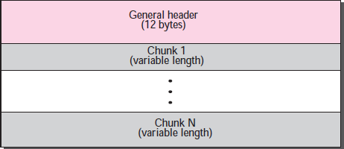
SCTP Features
Main Parts are
General header
Chunks – set of blocks
Types of chunks
Control chunks - controls and maintains the association
Data chunks - carries user data
SCTP packet format

Slide 62
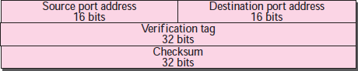
SCTP Packet Format
General Header
Defines the end points of each association to which the packet belongs.
Guarantees for a packet belongs to a particular association.
Preserves the integrity of the contents of the packet.
There are four fields in the general header
Source port address: 16-bit field defines the port number of the sender process
Destination port address: 16-bit field defines the port number of the receiving process
Verification tag: Number that matches a packet to an association
It serves as an identifier for the association
Separate verification used for each direction in the association.
Checksum: 32-bit field contains a CRC-32 checksum
General header

Slide 63
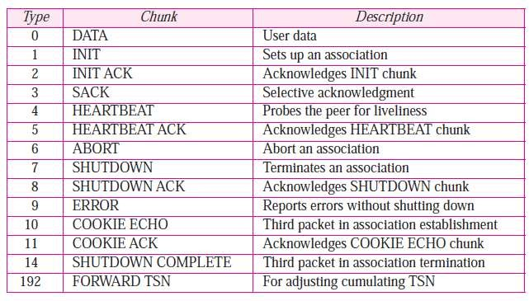
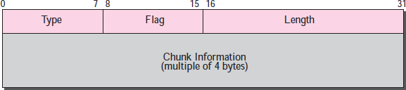
SCTP Packet Format
Chunks
Control information or user data are carried
First three fields are common to all chunks
Type: 8-bit field define up to 256 types of chunks(few have been defined, rest are reserved for future use)
Flag: 8-bit field defines special flags that a particular chunk may need.
Length: 16-bit field defines the total size of the chunk, in bytes, including the type, flag, and length fields
Information field depends on the type of chunk.
SCTP requires the information section to be multiples of 4 bytes
If not, padding bytes (eight 0s) are added at the end of the section
Types of Chunks
Common layout of a chunk

Slide 64
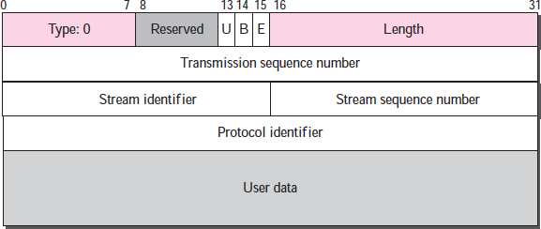
SCTP Packet Format
Data Chunk
Carries the user data
A packet may contain zero or more data chunks
Common fields
Type field has a value of 0
Flag field has 5 reserved bits and 3 defined bits
U - signals unordered data
B - beginning bit of fragmented message
E - end bit of fragmented message
TSN - Sequence number initialized in an INIT chunk for one direction and in the INIT ACK chunk for the opposite direction
SI - all chunks of same stream in one direction have same stream identifier
Protocol identifier: 32-bit field used by the application program to define the type of data which is ignored by SCTP
User data: carries the actual user data
No chunk can carry data belonging to more than one message
A message can be spread over several data chunks
Must have at least one byte of user data, can’t be empty
If the data cannot end at a 32-bit boundary, padding must be added
DATA chunk

Slide 65
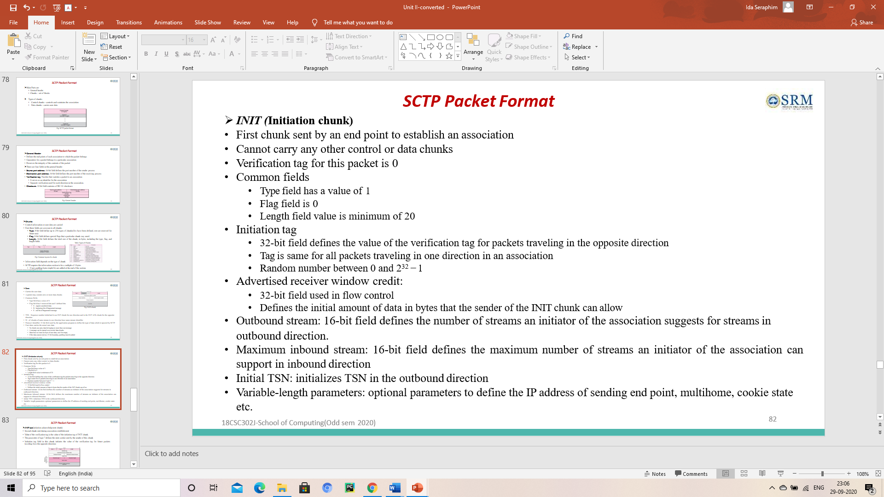
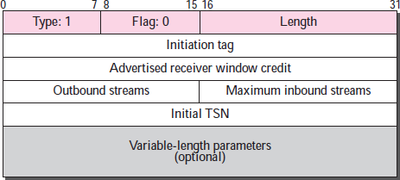
SCTP Packet Format
INIT chunk

Slide 66
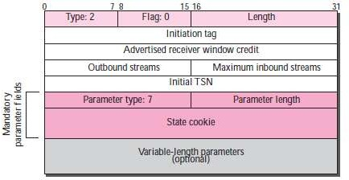
SCTP Packet Format
INIT ack(initiation acknowledgment chunk)
Second chunk sent during association establishment
Value of the verification tag is the value of the initiation tag of INIT chunk.
The parameter of type 7 defines the state cookie sent by the sender of this chunk
Initiation tag field in this chunk initiates the value of the verification tag for future packets traveling from the opposite direction.
INIT ACK chunk

Slide 67
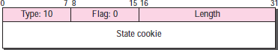
SCTP Packet Format
Cookie echo
Third chunk sent during association establishment that carry user data too.
Sent by the end point that receives an INIT ACK chunk.
Chunk of type 10.
COOKIE ACK
fourth and last chunk sent during association establishment with data chunk too.
sent by an end point that receives a COOKIE ECHO chunk.
chunk of type 11.
COOKIE ECHO chunk
COOKIE ACK

Slide 68
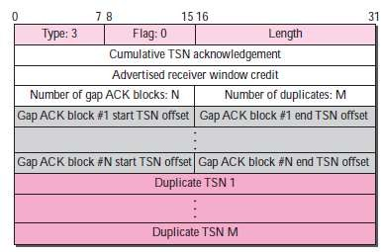
SCTP Packet Format
SACK(selective ACK chunk)
Acknowledges the receipt of data packets
Common fields
Type field has 3
Flag bits are set to 0s
Cumulative tsn acknowledgment: 32-bit field defines the tsn of the last data chunk received in sequence
Advertised receiver window credit: 32-bit field that have updated value for the receiver window size
Number of gap ACK blocks: 16-bit field defines the number of gaps in the data chunk received after the cumulative
TSN
Number of duplicates: 16-bit field defines the number of duplicate chunks following the cumulative TSN
Gap ACK block start offset: 16-bit field gives the starting TSN relative to the cumulative TSN
Gap ACK block end offset: 16-bit field gives the ending TSN relative to the cumulative TSN
Duplicate tsn: 32-bit field gives the tsn of the duplicate chunk.
SACK chunk

Slide 69
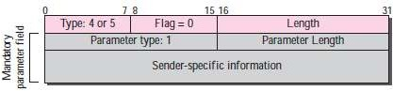
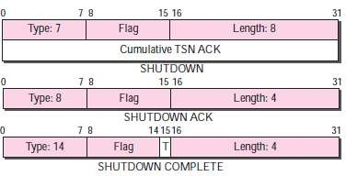
SCTP Packet Format
HEARTBEAT and HEARTBEAT ACK
First has a type of 4 and the second a type of 5
Used to periodically probe the condition of an association
An end point sends a HEARTBEAT chunk, peer responds HEARTBEAT ACK if it is alive
Parameter fields provide sender-specific information like address and local time
Same is copied into the HEARTBEAT ACK chunk.
SHUTDOWN, SHUTDOWN ACK, and SHUTDOWN COMPLETE
Used for closing an association
Shutdown
Type 7 is eight bytes in length
Second four bytes define the cumulative TSN
SHUTDOWN ACK: type 8 is four bytes in length.
Shutdown complete
Type 14 is 4 bytes long
T flag is 1 bit flag shows that the sender does not have a TCB table
HEARTBEAT and HEARTBEAT ACK chunks
SHUTDOWN, SHUTDOWN ACK, and
SHUTDOWN COMPLETE chunks

Slide 70
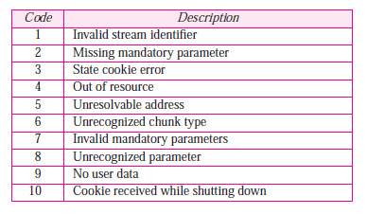
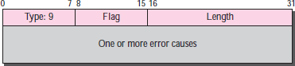
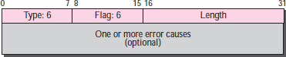
SCTP Packet Format
ERROR
Sent when an end point finds some error in a received packet.
It does not imply the aborting of the association.
ABORT
Sent when an end point finds a fatal error and needs to abort the association.
FORWARD TSN
This is a chunk recently added to the standard to inform the receiver to adjust its cumulative TSN
Errors
ERROR chunk
ABORT chunk

Slide 71
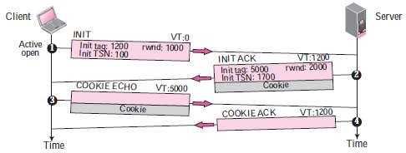
SCTP Client/Server(Association)
Association Establishment
Four-way handshake
First packet has INIT chunk sent by client
Verification tag is 0
Rwnd is advertised in a SACK chunk
Inclusion of a DATA chunk in the third and fourth packets
Second packet has INIT ACK chunk sent by server
Verification tag is the initial tag field in the INIT chunk
Initiates the tag to be used in the other direction
Defines the initial TSN and sets the servers’ rwnd
Third packet has COOKIE ECHO chunk sent by client
Echoes the cookie sent by the server
Data chunks are included in this packet
Fourth packet has COOKIE ACK chunk sent by server
Acknowledges the receipt of the COOKIE ECHO chunk
Data chunks are included with this packet.
Four-way handshaking

Slide 72
SCTP Client/Server(Association)
Number of Packets Exchanged
Number of packets exchanged is four(3 for TCP)
Allows the exchange of data in the third and fourth packets, so it is efficient
Verification tag
It is a common value carried in all packets traveling in one direction in an association
Blind attacker cannot inject a random packet into an association
A packet from an old association cannot show up in an incarnation
Cookie
Cookie is sent with the second packet to the address received in the first packet
If the sender of the first packet is an attacker, the server never receives the third packet
If the sender of the first packet is an honest client, it receives the second packet, with the cookie

Slide 73
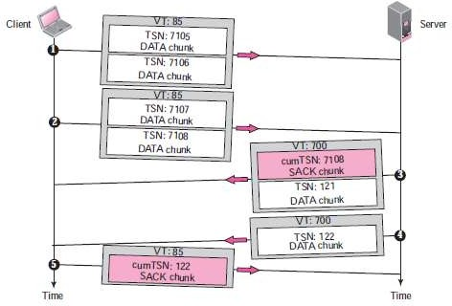
SCTP Client/Server(Association)
Data transfer
Purpose of an association is to transfer data between two ends.
Once association is established, bidirectional data transfer can take place.
SCTP supports piggybacking.
Each message coming from the process is treated as one unit and inserted into a DATA chunk.
Each DATA chunk formed by a message or a fragment has one TSN and acknowledged by SACK chunks.
Simple data transfer

Slide 74
SCTP Client/Server(Association)
Multihoming Data Transfer
Allows both ends to define multiple IP addresses for communication.
One address is primary address, rest are alternative addresses.
The primary address is defined during association establishment.
Primary address of the destination is used by default for data transfer, if it is not available, one of the alternative addresses is used.
SACK is sent to the address from which the corresponding SCTP packet originated.
Multistream delivery
TSN numbers are used to handle data transfer whereas delivery of the data chunks are controlled by SIs and SSNs.
Two types of data delivery in each stream
Ordered: SSNs define the order of data chunks in the stream.
Unordered: U flag is set, it delivers the message carrying the chunk to the destination application without waiting for the other messages.

Slide 75
SCTP Client/Server(Association)
Fragmentation
SCTP preserves the boundaries of the message when creating DATA chunk from a message
If the total size exceeds the MTU, the message needs to be fragmented
Steps for fragmentation
Message is broken into smaller fragments to meet the size requirement
DATA chunk header is added to each fragment that carries a different TSN
All header chunks carry the same SI, SSN, payload protocol identifier and U flag
B and E are assigned as
First fragment: 10
Middle fragments: 00
Last fragment: 01
Fragments are reassembled at the destination

Slide 76
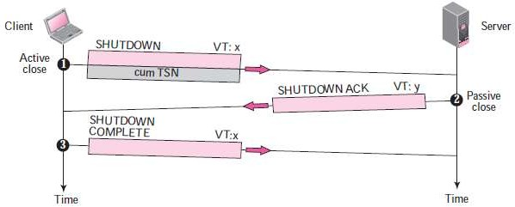
SCTP Client/Server(Association)
Association Termination (Graceful termination)
Either client or server involved in exchanging data can close the connection
SCTP does not allow a “half closed” association, i.e. if one end closes the association, the other end must stop sending new data
If not, the data in the queue are sent and the association is closed
Association termination uses three packets
SHUTDOWN
SHUTDOWN ACK
SHUTDOWN COMPLETE
Association termination

Slide 77

SCTP Client/Server(Association)
Association abortion
Association in SCTP can be aborted based on request by the process at either end or by SCTP
A process may wish to abort the association if the process receives wrong data from the other end, going into an infinite loop etc.
Server may wish to abort since it has received an INIT chunk with wrong parameters, requested resources are not available after receiving the cookie, the operating system needs to shut down etc.
For abortion process either end can send an abort chunk to abort the association
Association abortion

